Slide 1
Topic 8 Steady-Flow Devices
Thermodynamics: An Engineering Approach
8th Edition Yunus A. Çengel, Michael A. Boles
McGraw-Hill, 2015

Slide 2
Objectives
Solve energy balance problems for common steady-flow devices such as nozzles, compressors, and turbines.

Slide 3
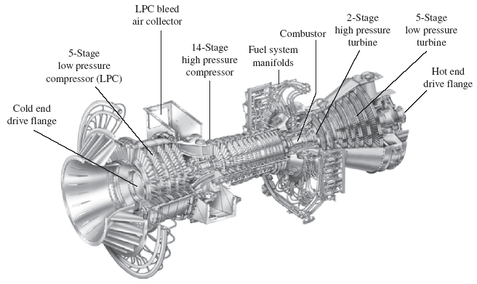
SOME STEADY-FLOW ENGINEERING DEVICES
Many engineering devices operate essentially under the same conditions
for long periods of time. The components of a steam power plant (turbines,
compressors, heat exchangers, and pumps), for example, operate nonstop for
months before the system is shut down for maintenance. Therefore, these devices can be conveniently analyzed as steady-flow devices.
A modern land-based gas turbine used for electric power production. This is a General Electric LM5000 turbine. It has a length of 6.2 m, it weighs 12.5 tons, and produces 55.2 MW at 3600 rpm with steam injection.

Slide 4
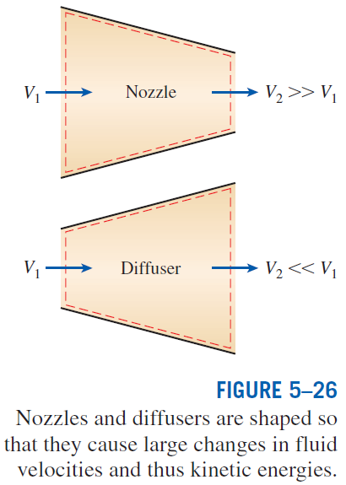
Nozzles and Diffusers
Nozzles and diffusers are commonly utilized in jet engines, rockets, spacecraft, and even garden hoses.
A nozzle is a device that increases the velocity of a fluid at the expense of pressure.
A diffuser is a device that increases the pressure of a fluid by slowing it down.
The cross-sectional area of a nozzle decreases in the flow direction for subsonic flows and increases for supersonic flows. The reverse is true for diffusers.
Energy balance for a nozzle or diffuser:

Slide 5
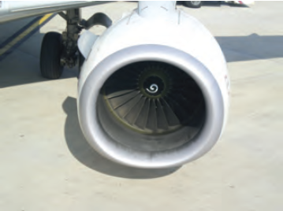
Deceleration of Air in a Diffuser
Air at 10ºC and 80 kPa enters the diffuser of a jet engine steadily with a velocity of 200 m/s. The inlet area of the diffuser is 0.4 m². The air leaves the diffuser with a velocity that is very small compared with the inlet velocity. Determine the mass flow rate of air and the temperature of the air leaving the diffuser.
Example 1

Slide 6
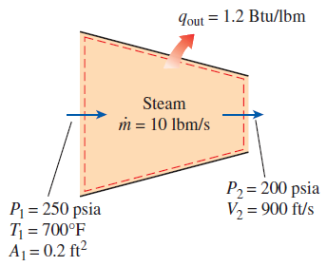
Acceleration of Steam in a Nozzle
Steam at 250 psia and 700ºF steadily enters a nozzle whose inlet area is 0.2 ft². The mass flow rate of steam through the nozzle is 10 lbm/s. Steam leaves the nozzle at 200 psia with a velocity of 900 ft/s. Heat losses from the nozzle are estimated to be 1.2 Btu/lbm. Determine the inlet velocity and the exit temperature of the steam.
Example 2

Slide 7
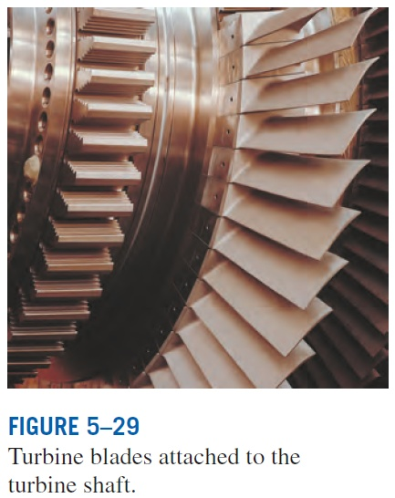
Turbines and Compressors
Turbine drives the electric generator In steam, gas, or hydroelectric power plants.
As the fluid passes through the turbine, work is done against the blades, which are attached to the shaft. As a result, the shaft rotates, and the turbine produces work.
Compressors, as well as pumps and fans, are devices used to increase the pressure of a fluid. Work is supplied to these devices from an external source through a rotating shaft.
A fan increases the pressure of a gas slightly and is mainly used to mobilize a gas.
A compressor is capable of compressing the gas to very high pressures.
Pumps work very much like compressors except that they handle liquids instead of gases.

Slide 8
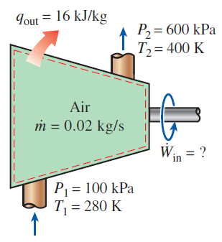
Compressing Air by a Compressor
Air at 100 kPa and 280 K is compressed steadily to 600 kPa and 400 K. The mass flow rate of the air is 0.02 kg/s, and a heat loss of 16 kJ/kg occurs during the process. Assuming changes in potential and kinetic energy are negligible, determine the necessary power input to the compressor.
Example 3

Slide 9
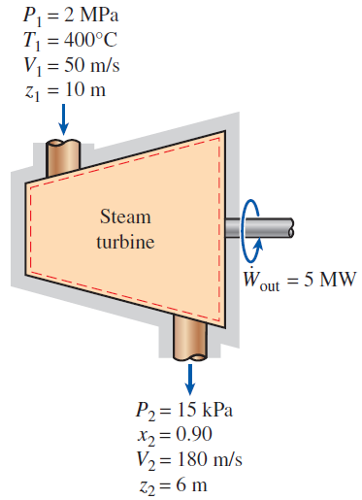
Power Generation by a Steam Turbine
The power output of an adiabatic steam turbine is 5 MW. The inlet and the outlet conditions are shown in the figure on the right.
Determine (a) the changes in enthalpy, kinetic energy, and potential energy and (b) the mass flow rate of the steam.
Example 4

Slide 10
Summary
Some steady-flow engineering devices
Nozzles and Diffusers
Turbines and Compressors

